Slide 1

Welcome to Hednesford Valley High School
Transition Presentation for Year 11
What Now? Where Next?
Thursday 3rd October 2024

Slide 2

“If you know you are on the right track, if you have this inner knowledge, then nobody can turn you off... no matter what they say.” – Barbara McClintock

Slide 3
KEY DATES
Autumn term:
    EHCP’s / College Open Days (Dates in Pack)
6th Form Application Deadline 9th December 2024
Spring term:
6th Form Interviews: Week beginning 13th January 2025
Assessment Weeks: January 2025 (over 2 weeks)
Coursework will be due in by the end of April
Summer term:
Exams May & June 2025
Leaver’s Party – Thursday 26th June 2025
Friday 27th June – Last Day for leavers
Transition to 6th Form 30th June 2025

Slide 4
Life Post Year 11
Under government guidance, ‘Raising Participation Age’ (RPA), all young people up to the age of 18 must remain in some form of education or training.
Under government legislation a young person must re-sit English or Maths GCSE if they do not achieve a Grade 4 or above.

Slide 5
Reporting Home
Your child will still receive an Annual report this year in the Summer Term
If you require predicted grades or references for College applications, your child can ask their subject teacher

Slide 6
How to best prepare for the Examinations
KS4 Revision Club (3pm-4pm)
Parents / Carers should check the student’s planner regularly and discuss revision throughout the year.
Remember your child should be revising at home in preparation for their exams.
Good sources for this are BBC Bitesize and
SENECA learning websites.

Slide 7
student Attendance
There is a clear link between absence and achievement
“Pupils who are persistently absent are just under 4 times less likely to achieve their target grades”
Department for Education.

Slide 8








What does your child need for their future?
The skills and knowledge that all students need for their future – see the Skills Builder website.
Preparation for their future role in the community / work.
A Starting point – what does your child want to do in the future?

Slide 9
Which Pathway?
HVH
Care Provision
Other School
6th Form
Lichfield
Cannock
Day Colleges
Your Child
Work-Based Learning
Nova Training
Rodbaston
Stafford
Residential Colleges
Tamworth
Walsall
Wolverhampton Vocational Training Centre
NATSPEC

Slide 10
Post 16 Transport
Unfortunately transport for post 16 students is not funded by the local education authority.
There are schemes available for low-income families which will contribute some of the cost of transport, but you will need to contact the establishment you are wishing your child to attend as to what the process of applying for it is, if you are eligible.
We can arrange travel training for your child, if appropriate, and the travel trainer will take your child to apply for a heavily discounted travel card.

Slide 11
Thinking of staying on in 6th Form?
What can we offer you?
Dedicated, well-trained staff
Generous accommodation for learning
English and Maths lessons led by specialists
Work related learning and experience
BTEC vocational courses
If you are applying to our 6th Form, we offer a bursary of up to £400 per term.

Slide 12
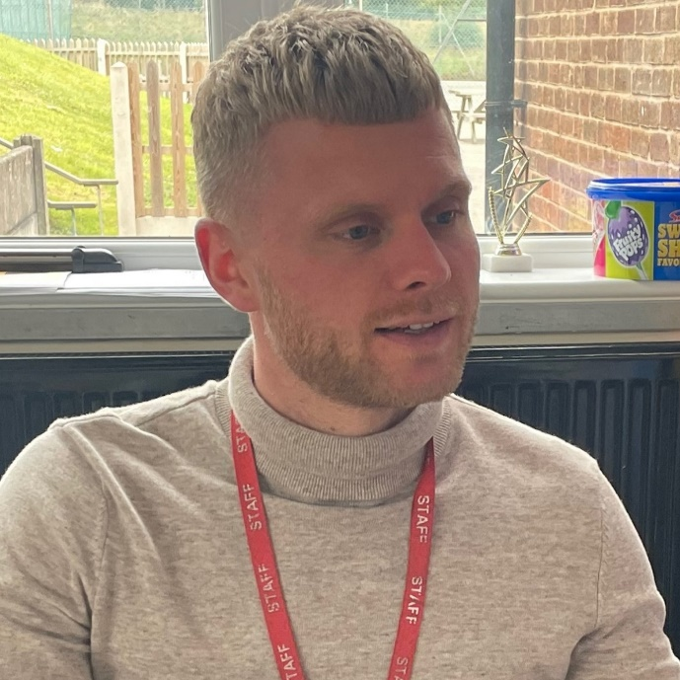
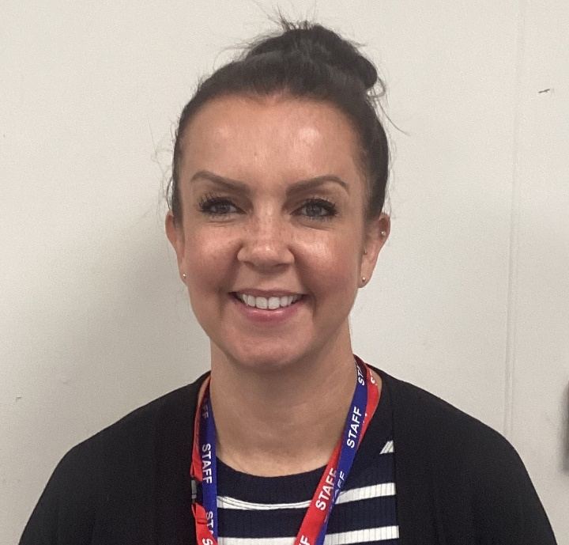
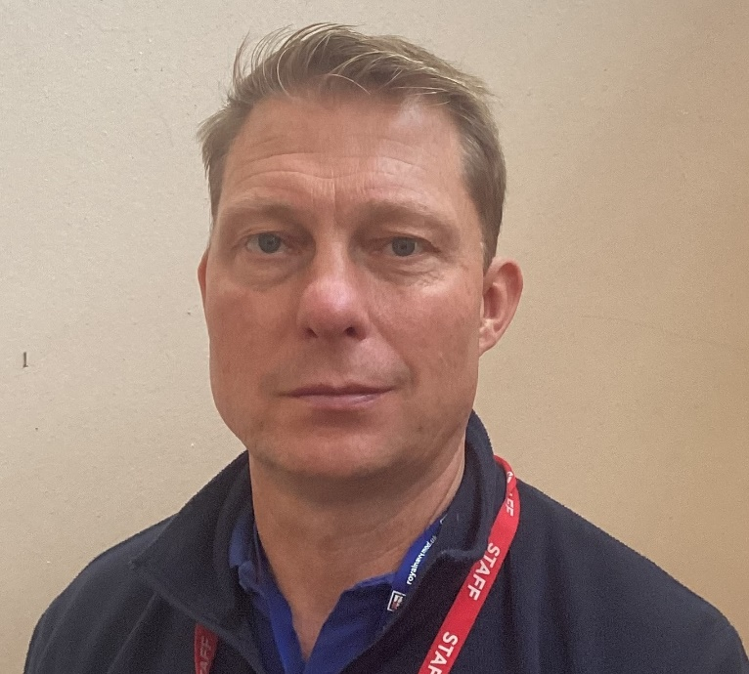
6th Form teaching Staff
Mr. Dale
6th Form
Co-ordinator
Mrs. Nicholls
Mr. Holmes

Slide 13
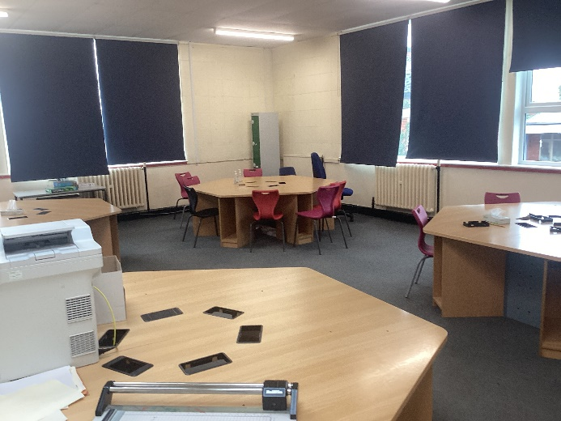
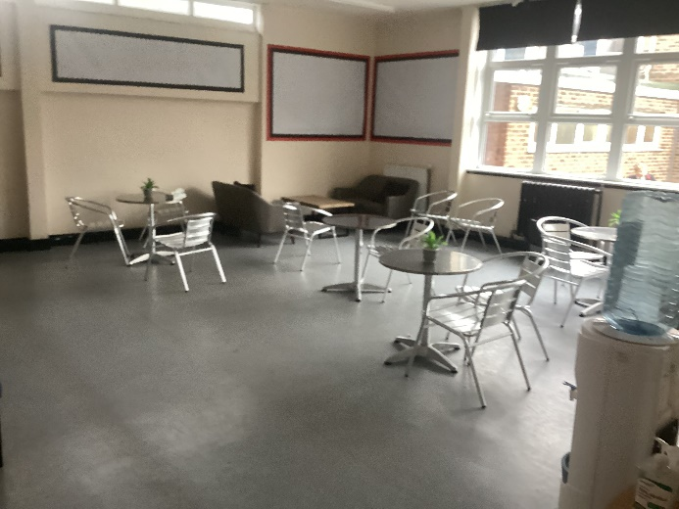
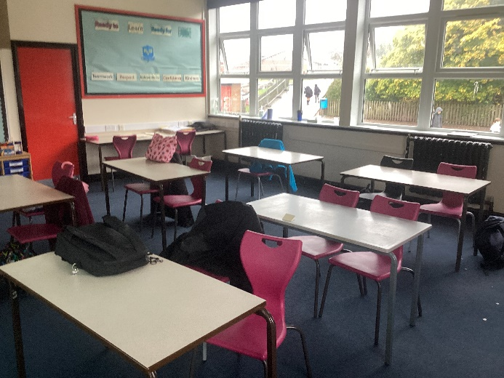
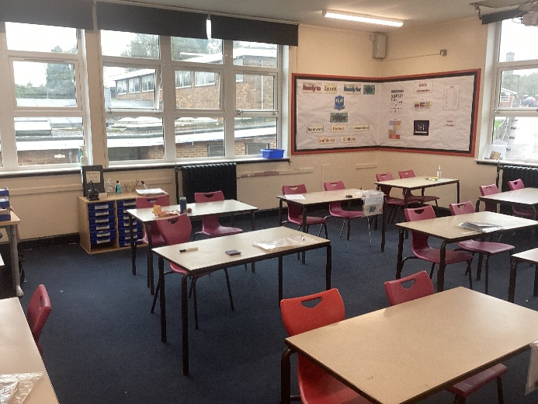
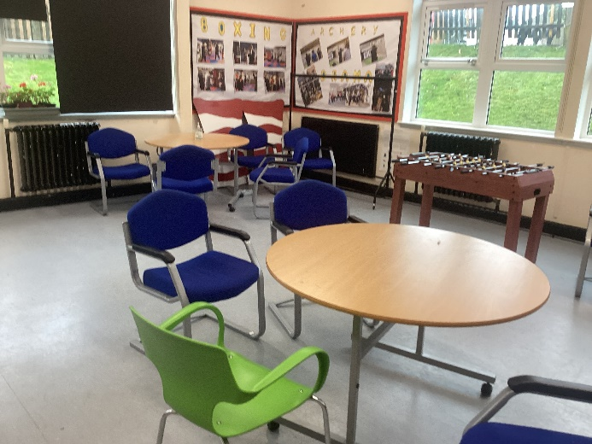
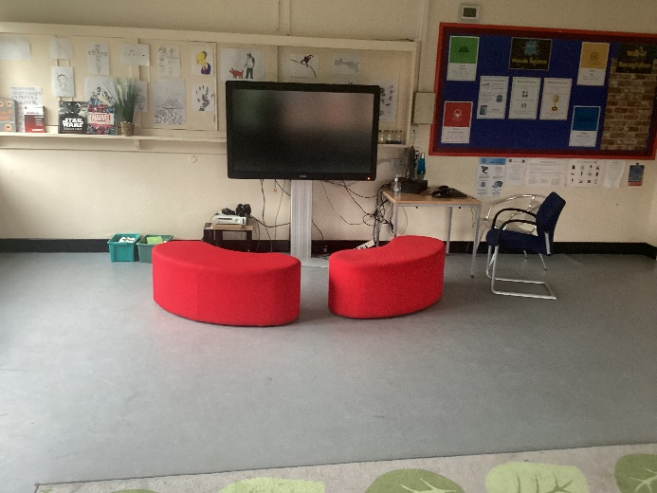
6th Form site
Independent Learning
Café
Classrooms
Common Room
Chill Out

Slide 14
Our Curriculum aims
The 6th Form curriculum is designed to provide students with the essential knowledge and skills necessary for achieving optimal life outcomes, building upon their previous accomplishments in school.
We are committed to continuously improving our 6th Form offerings by expanding the variety of accreditations and non-accredited activities available to our students.
Recognising that our sixth form students present a diverse range of needs and abilities, we have organised the department into distinct groups, each tailored with its own curriculum to maximize the life opportunities available to students.
Our curriculum is ambitious and adopts a highly personalised approach to learning, crafted specifically for each learner; we do not expect any student to conform to a predefined curriculum.
The curriculum is built upon four fundamental principles:
1. Independence Skills: Focused on daily living skills, functional skills, and personal self-help skills.
2. Meaningful Learning Activities: Including vocational education, accreditation and qualifications, careers guidance and work experience, as well as creative activities.
3. Preparation for Adulthood Skills: Emphasising social and communication skills as well as independent living skills.
4. Opportunities for Lifelong Learning: Establishing connections with post-school provisions, transition coordination and events, post-19 community facilities, and promoting strong links to British Values.

Slide 15
16 – 19 Curriculum
 | Explorer | Delta | Discovery | Apollo
Core | English | English | English | English
 | Maths | Maths | Maths | Maths
 | PSHE | PSHE | PSHE | PSHE
 | Humanities | RE | RE | RE
Life | Careers | Employability | Employability | Employability
 | Community Action | Community Engagement | Work Experience | Work Experience
 | Volunteering | Volunteering
 | Work Skills | Work Skills
 | Life Skills | Life Skills
 | Keeping a home | Horticulture
 |  | College
Options | Media (EL) | Drama | Drama | Drama
 |  | Media | Media | Media
 |  | Hospitality | Hospitality | Hospitality
Leisure | Sport | Art
 | Art | Sport
 | Adventure and Residential

Slide 16
Unsure what to do?
Make contact with different places – find out about any open events.
Visit so you can make informed decisions.
Talk to people around you, parents/carers, form tutors, friends and people in the community.

Slide 17
Know where you want to go?
Once you have decided where you want to go
Contact the place and ask for an application for that course. Ask your parents/carers and staff at school to check your filled form before you send it.
You must make sure you meet any deadlines for returning application forms.

Slide 18
Interview
You will be called to an interview. You will be given a date and a time. Make sure you arrive early and take someone like a family member with you to support you.
It is important you dress smartly for an Interview so make sure you have your smartest clothes on for example your school uniform.
Practice a few questions at home:
What do you want to do in the future?
What course do you want to study?
Why do you want to do that course?

Slide 19
Any Questions?
Mrs Perry: e.perry@hvh.staffs.sch.uk
Mr Wall: c.wall@hvh.staffs.sch.uk
Mr Dale: a.dale@hvh.staffs.sch.uk

